Slide 1
IHE
Patient Care Coordination
Keith W. Boone
Interoperability Architect, GE Healthcare
Co-chair, IHE PCC
Co-chair, HL7 Structured Documents
Co-chair, HITSP Care Management and Health Records Domain TC

Slide 2
Integrating the Healthcare Enterprise
Over 100 vendors and 20 professional societies involved worldwide
5 Technical Frameworks and 40+ integration profiles
Testing at Connectathons and Demonstrations at Major Conferences Worldwide
Electronic Health Record
1999
2002
Radiology
Cardiology
2002
IHE
Patient Care
Laboratory
2003
IT Infrastructure
2005
Coordination
Future
2005
Domains
Patient Care
2005
2004
Devices
2005
Pathology
Oncology
Eye Care

Slide 3

Patient Care Coordination
Established in 2005
Scope
  Integration issues that cross providers, patient problems or time.
  General clinical care aspects such as
    document exchange,
    order processing,
    coordination with other specialty domains.
  Address workflows and the integration needs of specialty areas without a separate domain within IHE
Notes:
Key messages
Meeting the requirements of the healthcare professionals when exchanging patient clinical information is critical: trust in the information and ease of access is paramount.

Slide 4

Sponsors and Professional Societies
Sponsors
  Health Information Management Systems Society
  American College of Physicians
Participating Professional Societies
  American College of Obstetricians and Gynecologists
  American College of Emergency Physicians
224 Organizational Members of IHE
  http://www.ihe.net/governance/member_organizations.cfm
Notes:
Meeting the requirements of the patient when exchanging its information is critical: trust in the information and protecting the privacy and confidentiality for the consumer is paramount.

Slide 5
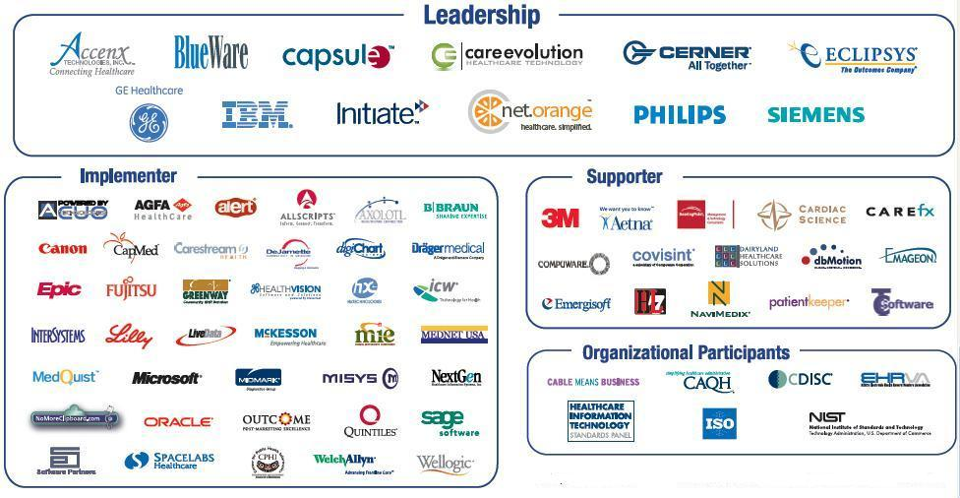
IHE Participants at HIMSS 2008

Slide 6
IHE– Development cycle
Development and Deployment
Proposed Scope
- 10 ---
2009 Season
Approved Scope
- 7 ---
Sponsors announce Connect-a-thon/Demos with set of Implementation Profiles
Public Comment
- 2 ---
Trial Implementation
0 ---
Connect-a-thon/Demo Vendor Participant Registered
+ 2 ---
+ 5 ---
Vendor Participant passed Connectathon
2008 Season
+ 6 ---
Demo &
Education Material
Final Integration Profile
+ 9 ---
Vendors release products with IHE Integration Statements
---
Notes:
- This slide is confusing
No representation of the development of the profiles
separate development and deployment areas and show how everything comes together in the end (fade in new pieces
1) development
2) deployment
3) entire process??
remove years
identify what the numbers on pink line represent (months)
possibly horizontal layout? Refer CCHIT gant chart
refer to HIMSS “circle slide” showing the process more simply

Slide 7
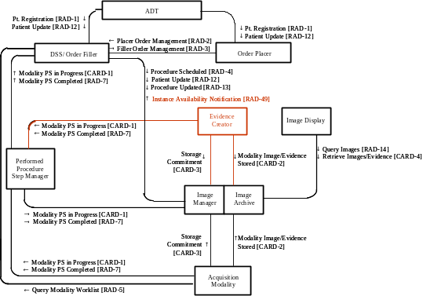
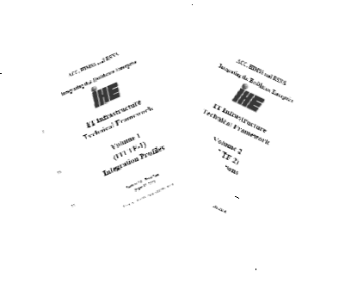
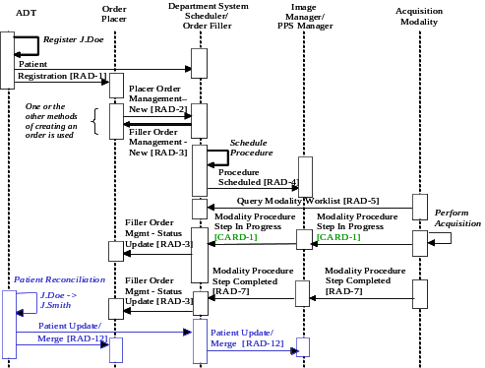
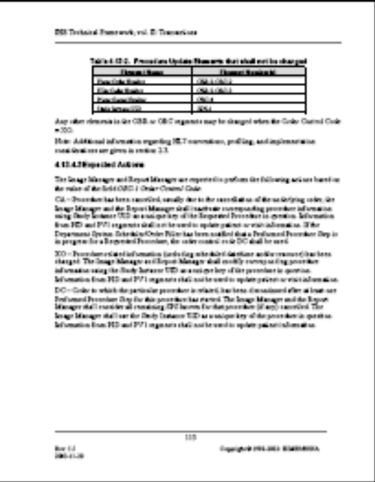
IHE Profiles
Actor/Transaction Diagrams
Sequence Diagrams
Detailed standards implementation guides
Textual Description

Slide 8
A content profile is…
A sharable information component that can be exchanged…
  within an HIE or RHIO (XDS)
  via Media or USB Device (XDM)
  via Reliable Messages (XDR)
Document content using standards
  CDA Release 2.0
  ASTM/HL7 Continuity of Care Document
Library of Reusable Parts

Slide 9
PCC Content Profiles
Standards and Profiles Used
CDA Release 2.0
ASTM/HL7 Continuity of Care Document
IHE XDS/XDR/XDM
Notification of Document Availability
Document Digital Signature
XHTML 1.0
XSLT 1.0

Slide 10
PCC Content Profiles
Key Technical Properties
Human Readable
Machine processable
Digital Signature Enabled
Can be shared multiple ways
  RHIO or HIE (XDS)
  CD or USB Media (XDM)
  Point to Point (XDR)

Slide 11
PCC Technical Framework
HL7 Clinical Document Architecture (CDA) Release 2
Structured and Coded Header
Level 1
Patient, A
uthor, Authenticator, Institution,
Header always structured and coded
Time of Service, etc.
S
t
r
u
c
t
u
r
e
d
C
o
n
t
e
n
t
w
i
t
h
c
o
d
e
d
s
e
c
t
i
o
n
s
:
Level 2
S
t
r
u
c
t
u
r
e
d
C
o
n
t
e
n
t
w
i
t
h
c
o
d
e
d
s
e
c
t
i
o
n
s
:
Title
-
coded sections with non
•
Reason for Referral
-
structured
•
nor coded content (text, lists, tables).
•
Vital Signs
➔ Simple Viewing (XML Style sheet)
•
•
M
e
d
i
c
a
t
i
o
n
M
e
d
i
c
a
t
i
o
n
Level 3
Med, Problems and Allergies
Text Structure
Coded Section
as highly structured text.
Entry
Entry
➔Text easy to import/parse
•
Studies
•
•
A
l
l
e
r
g
i
e
s
A
l
l
e
r
g
i
e
s
Level 3
Med Problems a
nd
Text Structure
Coded Section
Allergies have a
Entry
Entry
fine-grain structure with
•
Social History
optional coding. Coding
•
Scheme explicitly identified.
•
P
r
o
b
l
e
m
s
P
r
o
b
l
e
m
s
Text Structure
Coded Section
The PCC Technical Framework
enable both semantic
interoperability and simple viewing !
Entry
Entry
•
Care Plan
Notes:
One of the most common information exchange neeed is to create an summary of a patient chart and share for other care provider to import. In this type of document, it is clear that the information content is not only textual information, but highly structured information for the most important information, medication, allergies, diagnosis, and patient demographics informations. This IHE medical summary, XDS-MS is based on the HL7 CDA release 2 standard, just like the PHR extract, XPHR, which is aligned on the ASTM/HL7 CCD implementation guide.

Slide 12
PCC TF as a Library of Templates
Documents Sections Entries Parts
Referral
Problems
Problem
Severity
XPHR
Vitals
Vital
LAB
Result
Obs

Slide 13
IHE PCC Profiles
Functional
Status
Assessments
Medical Summaries
Immunization
Registry
Content
ED
Referral
Exchanging
PHR
Content
Emergency
Department
Encounter
Summary
Antepartum
Care
Summary
Antepartum
Record
Clinical
Research
Cancer
Registry
Content
Integration Content
Query for Existing Data
2005-06
2006-07
2007-08
2008-09
Care Management
Notes:
Update for 2009-10
readability with text and background colors

Slide 14
Medical Summaries
Abstract
Define a medical summary format for clinical documents containing:
  Patient Demographics
  Problems
  Allergies
  Medications
  Pointers to other material
Notes:
As I said, last year we started with the medical summary content profile. The basic abstract of this profile was to support the exchange of the following five key pieces of information in a way that would allow machine to machine readability of the content. You will note that already this profile covers the following data elements: Allergies, Medications, and most Patient Registration data. Although not listed as part of the abstract above, it is also possible to include limited Insurance information, including the provider and specific policy numbers.

Slide 15
Medical Summaries
Value Proposition
Leverages Clinical Documents and Ontology
  A common mechanism for transfer of encoded clinical data embedded in documents (CDA)
Enhances Clinical Documents criteria for key use cases:
  Inpatient to Primary Care Provider
  Primary Care Provider to Specialist
HL7 CCD Compatible
Notes:
We build a clinical document ontology, and came up with a common mechanism to transfer encoded clinical documents, with specific need to address transfer of care scenarios. This slide, from last year, only shows the plan to update for Home Health Care and Long Term Care. Even so, we knew even then that we would be going to other sorts of clinical documents for other use cases.

Slide 16
Emergency Department Referral
Abstract
Define a referral format for "heads-up" call
  Supports Medical Summary Content
  Special Needs of Emergency Department
    Expected Time of Arrival
    Mode of Arrival
    Disposition/Orders
Notes:
As I said, last year we started with the medical summary content profile. The basic abstract of this profile was to support the exchange of the following five key pieces of information in a way that would allow machine to machine readability of the content. You will note that already this profile covers the following data elements: Allergies, Medications, and most Patient Registration data. Although not listed as part of the abstract above, it is also possible to include limited Insurance information, including the provider and specific policy numbers.

Slide 17
Exchange of PHR Content
Abstract
Manage the interchange of documents between a PHR System and an EHR System to enable interoperability.
Supports a variety of transmission mechanisms.
Addresses PHR Update Issues
Notes:
The XPRH profile builds upon the work done with XDS-MS, but makes an attempt to fill many of the gaps between a medical summary and a PHR extract. Since we had already covered significant ground in that area, we wanted to see how far we could push the envelope. The AHIMA PHR data set provided a target data set that we were able to show as being a fairly complete model of information going into a PHR, without entering into yet another debate about standards selection.
One of the key issues that we discovered during the development of this profile is the need for an update model to record updates to the PHR data. Physicians and other healthcare practitioners were fairly clear in telling us that they did not want to take on the responsibility for the entire universe of content that might be present in an extract from a PHR. They felt that updating a PHR extract and so that it contained all of its prior content, plus/minus any changes they made, would put them in that situation. Also important was the fact that many of their information systems would not be able to "import" the content, then export a new content which would convey their intent.
To give an example, I have two extracts which contain only problem lists. Extract 1 says that the Patient has a Bacterial Inner Ear Infection. Extract 2, produced at a later time indicates that the Patient has a Fungal Inner Ear Infection.
What has happened here?
There are at least three possible scenarios:
The bacterial inner ear infection was previously resolved, but now the patient has a fungal inner ear infection as a new problem.
The patient also has a fungal inner ear infection on top of the bacterial inner ear infection.
The original diagnosis of a bacterial inner ear infection was incorrect, this was really a fungal inner ear infection.
PHR Systems should not have to infer what happened by viewing the two extracts, because
They don't have the necessary information.
Heuristics, which might be OK for "syncronizing" your PDA, are not safe when patient health issues are at stake.
Their operators (patients), also do not necessarily have the clinical understanding to make the right choices.
The issue that physicians identified is that when helping a patient update a PHR, they need the ability to:
Change only certain information, without taking responsibility for the rest,
Indicate the intent of the change.
It's not enough to just eliminate the problem from the current problem list. There EHR system might not handle certain classes of problems (for example, they may not be able to handle certain specialist diagnoses [e.g. dental]). So physicians only want to record the changes that they themselves are responsible for suggesting, not create a new PHR extract based on the changes they made to a previous one.

Slide 18
Exchange of PHR Content
Value Proposition
Supports interchange of PHR Information
  Demographics
  Insurance Information
  Medications, Problems, Allergies
  Health History
  Other Information
Supports information described in
  AHIMA PHR Common Data Elements
  HL7 PHR Functional Model
HL7 CCD Compatible
Notes:
The value proposition is really understated on this slide. In addition to Problems, Meds, Allergies and Demographics, this profile supports the encoding of a wide variety of other information content: Vital Signs, Lab Results, Health History, Social History, Prior Encounters, et cetera.

Slide 19
Antepartum Summary
Scope
Transmission of Prenatal Flowsheet information between Perinatal, ambulatory and inpatient EHR systems

Slide 20
Antepartum Summary
Value Proposition
Over 4 million live births per year in US
Obstetric patients must have a complete summary of antepartum care available for all care providers and at admission for labor and delivery.
Incomplete information can be a danger to the mother and child and result in injury, inadequate treatment or undesirable outcome.

Slide 21
Functional Status Assessment
Scope
The Institute of Medicine has determined that a high risk for errors occurs during the transfer of care.
The Functional Status Assessment Profile (FSA) supports the handoff of assessment information between practitioners during transfers of care, cross-enterprise or intra-enterprise.
Physician documentation provides medical assessment, diagnosis and treatment information.
Nursing documentation provides assessment and treatment of human response (psychosocial, physiologic, emotional and spiritual) of patient/family to changing conditions.

Slide 22
Functional Status Assessment
Value Proposition
Early intervention by practitioners viewing EHR minimizes complications and reduces length of stay.
Ensure pertinent data is available at the time of transfer without concern about lost data.
Complete information about patient’s clinical or home status promotes safety, adequate after-care, improved outcomes and patient satisfaction.
Admitting nurse can plan for appropriate staffing resources based on patient acuity. (Resource maximization)
Continuity of interdisciplinary plan of care promotes early discharge and increased patient satisfaction.

Slide 23
ED Encounter Summary
Scope
Emergency Department Information Systems (EDIS)
Inpatient EHR Systems
Ambulatory EHR Systems

Slide 24
ED Encounter Summary
Value Proposition
The Centers for Disease Control and Prevention (CDC) estimates that there were over 110 million emergency department visits in 2004
ED visits account for as much as 40% of hospital admissions
The ED Chart is the most common medical summary in use today
This profile supports sharing of the clinical information in the ED chart with inpatient care providers and the patient's primary care physician.

Slide 25
Query for Existing Data
Abstract
Exchange of information between Data Repositories and Clinical Data Consumers for:
  Drug Safety
  Public Health, Biosurveillance and Disease Registries
  Identifying Qualifying Patients
    Clinical Trials
    Disease Management
  Quality Reporting
  Claims Submission

Slide 26
Query for Existing Data
Scope
Problems and Allergies
  Disease Registries, EHR Systems
Vital Signs
  Monitoring Systems, EHR Systems
Diagnostic Results
  Laboratory and Radiology Information Systems, EHR Systems
Medications
  Pharmacy, EHR Systems
Immunizations
  Immunization Registries, EHR Systems
Professional Services
  Practice Management Systems
Decision Support Systems

Slide 27
Query for Existing Data
Key Technical Properties
Web Services and SOA Architecture
Use of one standard for all queries
Reuse of PCC Technical Framework Templates
Compatibility with ASTM/HL7 CCD

Slide 28
Query for Existing Data
Value Proposition
Typical institutions have a large number of interfaces (30 – 60 or more) to manage, at a cost of $10,000 to $20,000 per year per interface. Few HL7 Version 2.X interfaces provide any query capabilities.
Supporting a single standard to query clinical information is expected to reduce the overall costs of hooking together discrete clinical information systems.

Slide 29
PCC Activities for 2008-2009
Care Management
  Chronic Disease Management
  Immunization Registries
  Cancer Registries
Clinical Research
Antepartum Record
Medical Home

Slide 30
Care Management
Abstract
The Care Management Profile supports the exchange of information used between HIT systems and applications used to manage care for specific conditions

Slide 31
Care Management
Scope
EMR Systems
PHR Systems
Chronic Disease Management Systems
Immunization Registries
Cancer Registries
Home Health Monitoring Systems
Imaging Systems
Laboratory Systems

Slide 32
Care Management
Value Proposition
Easily configure data capture data for:
  Chronic Disease Management
    Diabetes, CHF, COPD, Hypertension, Obesity…
  Immunization Reporting
  Tumor Reporting

Slide 33
Care Management
Key Technical Properties
Support for exchange of information using evidence based guidelines to drive data capture
Compatible with HL7 V2 and V3 messaging

Slide 34
Clinical Research
Abstract
Exchange data needed for Clinical Trials research between EMR systems and Electronic Data Capture Systems

Slide 35
Clinical Research
Scope
Electronic Medical Records (EMR)
Electronic Data Capture (EDC) systems
Clinical Data Management Systems (CDMS)
Data Archiving systems
Biopharmaceutical sponsor protocol systems

Slide 36
Clinical Research
Value Proposition
Pre-population of commonly used data fields for Clinical Trials

Slide 37
Clinical Research
Key Technical Properties
Supports separate storage of Clinical and Research data
Communicates using appropriate standards
  HL7 V3/CDA for Communication from EMR
  CDISC for Communication to EDC
Integrates Clinical Research data access into EMR

Slide 38
Antepartum Record
Abstract
The Antepartum Record continues the description of the content structures for the ACOG Antepartum Record Forms as begun in the Antepartum Summary Profile.
  Forms A&B - The initial assessment and physical
  Form D - Laboratory Evaluations
  Form E - Education Assessment
This profile defines the implementation of HL7 CDA documents to represent the data elements from forms A, B, D, and E, along with the XDS, XDR and XDM bindings. This profile also defines mechanisms to group them into a single logical folder.

Slide 39
Antepartum Record
Scope
EMR Systems within Ambulatory/Obstetric offices
Labor and Delivery Departmental Systems
Hospital HIS Systems
EMR Systems within Pediatric offices
RHIO and/or HIE Systems

Slide 40
Antepartum Record
Value Proposition
Share Prenatal Visit Information with Delivery Locations
Capability to electronically communicate all pertinent patient history, treatment, lab and imaging information collected over the course of a pregnancy to care providers and institutions (ambulatory, hospital, specialist, etc.) via perinatal, ambulatory and inpatient EHR systems.

Slide 41
Antepartum Record
Key Technical Properties
Use of IHE XDS, XDM or XDR to share records
Use of Folders to store all information needed for each pregnancy
Use of HL7 Clinical Document Architecture to store document information
SNOMED and LOINC to code results
Based on standardized forms used for Perinatal Care

Slide 42
IHE PCC Nursing Subcommittee
PCC Approved the formation of a Nursing Subcommittee in November 2008
  Membership open to any IHE Member
    See www.ihe.net/governance
  Call for Co-chair Nominations occurring soon
Initial Focus
  Review of ALL IHE Activities involving Nursing
  Leading development of Nursing specific profiles
  Liaison with other IHE Domain

Slide 43
Categories of Healthcare Communication Services
HIEs and RHIOs
Patient and Provider ID Mgt
Hospitals
e.g. access to last 6 months historical labs and encounter summaries
e.g. get a current list of allergies or med list from a source
e.g. order a lab test, track status and receive results
Security
Document
Sharing
Dynamic
Information
Access
Workflow
Management
Source persisted and attested health records
Specific info snapshot
provided on demand
2 or more entities
synchronize
a task
Notes:
The different services performing health information exchange fall in three categories. Hospitals have traditionally use primarily Workflow Mgt type and Dynamic Query services. Document Sharing, little used in hospitals, is however one of the primary mode of information exchange is the sharing of persisted and attested health records among independent organizations. We will focus on Document sharing in the next few slides.

Slide 44


Use of a shared XDS Infrastructure
Between Providers and :
  Specialists
  Patients
Hospital
Ambulatory or Specialty Center
Home
Notes:
The very same IHE XDS infrastructure used to share medical summaries, may alos be used to share diagnosis images and imaging reports. This is specified by the XDS-I integration proifile.

Slide 45
Combining IHE Profiles
Document Content & Modes of Document Exchange
Doc Content Profiles (Semantics content)
Scanned Doc
XDS-SD
Consent
BPPC
Emergency
EDR
ED Encounter
Summary
EDES
Functional Status
Assessment
FSA
Imaging
XDS-I
Laboratory
XD*-Lab
Discharge &
Referrals
XDS-MS
PHR
Exchange
XPHR
Document Exchange Integration Profiles
Document
Sharing
XDS
Reliable Pt-Pt
Interchange
XDR
Media
Interchange
XDM
Notes:
IHE Integration Profiles offer flexibility in that they can be mixed and matched to meet a broad range need.
This slide illustrates that not only XDS may be used to exchange documents, by interchange media such as USB keys and CDs are specified by the XDM Integration Profile. Likewise a varity of content

Slide 46












IHE, global standards-based profiles adopted by several national & regional projects
Netherland
Amsterdam
Lower
Austria
Italy
(Conto Corrente Salute)
UK CfH
(Radiology WF)
France
DMP
Denmark (Funen)
Italy (Veneto)
Spain (Aragon)
Quebec, Toronto,
Alberta, British Columbia
Canada Infoway
Austria
VITL-Vermont
Boston Medical Center - MA
Philadelphia HIE
CPHIC – Pennsylvania
CareSpark – TN & VA
South Africa
CHINA-Shanghai
Imaging Info Sharing
Malaysia
CHINA-MoH
Lab results sharing
JAPAN-Nagaya
Imaging Info Sharing
THINC- New York
NCHICA – N. Carolina

Slide 47
How can I participate?
As a Provider or Vendor Contributor
Offer Clinical Use Case Input to Drive IHE Profile Development
Become a member of relevant domain’s Planning or Technical Committees
Become a member of relevant Regional/National Committees
Help to shape IHE’s future direction
As a Vendor Participant
Respond to Public Comments of Domain Supplements
Attend the June Educational Workshop
Participate in Connect-a-thons and Demonstrations
As a Provider/Consultant Participant
Respond to Public Comments of Domain Supplements
Attend the June Educational Workshop
Attend Demonstrations and include IHE Integration Profiles in your RFPs and Integration Projects.

Slide 48
What can you do?
Attend the IHE Domain specific sessions in these Theaters during HIMSS 2007 (Orange sessions)
Learn about IHE, www.ihe.net
Insist on relevant IHE profiles compliance in your RFPs and contract documents:
  Select Integration Profiles, and Appropriate Actor(s)
  Ask vendors for their products “IHE Integration Statements”.
Need more interoperability ?
  Contribute to IHE Committees

Slide 49
Patient Care Coordination
Schedule for 2008 - 2009
Development Schedule
Technical Committee Face to Face: March 2008
Technical Committee Face to Face: May 2008
Issue Public Comment version: June 2008
Public Comment Due: July 2008
Technical Committee Face to Face: July 2008
Issue Trial Implementation version: August 2008
Planning Committee: October 2008
Technical Committee: November 2008
Planning Committee Decision: December 2008
IHE Connectathon: February 2009
HIMSS Demo: April 2009

Slide 50
IHE Web site: www.IHE.net
Frequently Asked Questions
Integration Profiles in Technical Frameworks:
http://www.ihe.net/Technical_Framework/index.cfm
  Cardiology
  Eye Care
  IT Infrastructure
  Laboratory
  Patient Care Coordination
  Patient Care Devices
  Pathology
  Quality
  Radiation Oncology
  Radiology
Connectathon Results: http://ihe.univ-rennes1.fr/con_result
Vendor Integrations: http://www.ihe.net/Resources/ihe_integration_statements.cfm

Slide 51


Slide 52

HIMSS NHIN: Network of networks
The largest multi-vendor HIE Prototype ever built !
Community
Network A
Community
Network B
Document Registry
Practice
Document Registry
Practice
Hospitals
Practice
Hospitals
3 infrastructure
systems
Practice
Hospitals
Practice
Hospital
Hospital
Practice
Hospital
Practice
Hospitals
Practice
Hospitals
Practice
Hospitals
Diag Test
Practice
Clinic
Clinic
Clinic
Diag Test
Clinic
Other
Clinic
Clinic
Clinic
Clinic
3 infrastructure
9 local systems
2 infrastructure
4 local systems
Community
Network C
Community
Network D
6 infrastructure
9 local systems
Document Registry
Document Registry
3 infrastructure
7 local systems
Hospitals
Hospitals
Practice
Hospitals
Practice
Hospitals
Practice
Practice
Clinic
Clinic
Notes:
This demonstration is introducing the ability to federate different Communities, each served by a different document registry from a different vendor. This represents fairly accurately a state RHIO that include three distinct communities. The number of different systems, not only different infrstrature systems but also edge systems such as EMR and other clinical systems that have reached full connnectivity makes this demonstration a multi-vendor RHIO protoptype, with tyhe largest variety of systems, ever built in the world.

Slide 53

NHIN-2 Projects
CareSpark – Tricities region of Eastern Tennessee and Southwestern Virginia
Delaware Health Information Network
Indiana University
Long Beach Network for Health
Lovelace Clinic Foundation – New Mexico
MedVirginia
New York eHealth Collaborative
North Carolina Healthcare Information and Communications Alliance, Inc. (NCHICA)
West Virginia Health Information Network

Slide 54
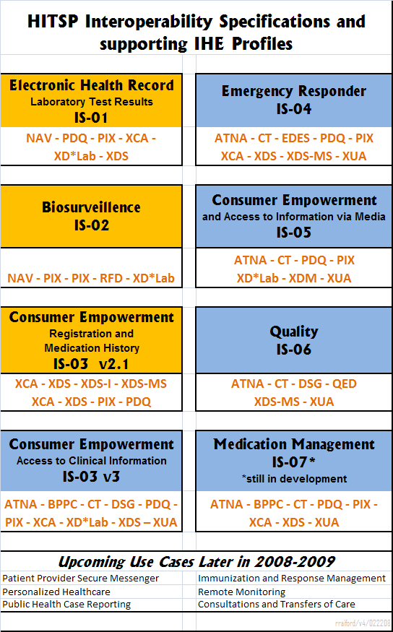
IHE Profiles are consistent with HHS Accepted Standards
(HITSP Interoperability Specifications)

